Slide 1
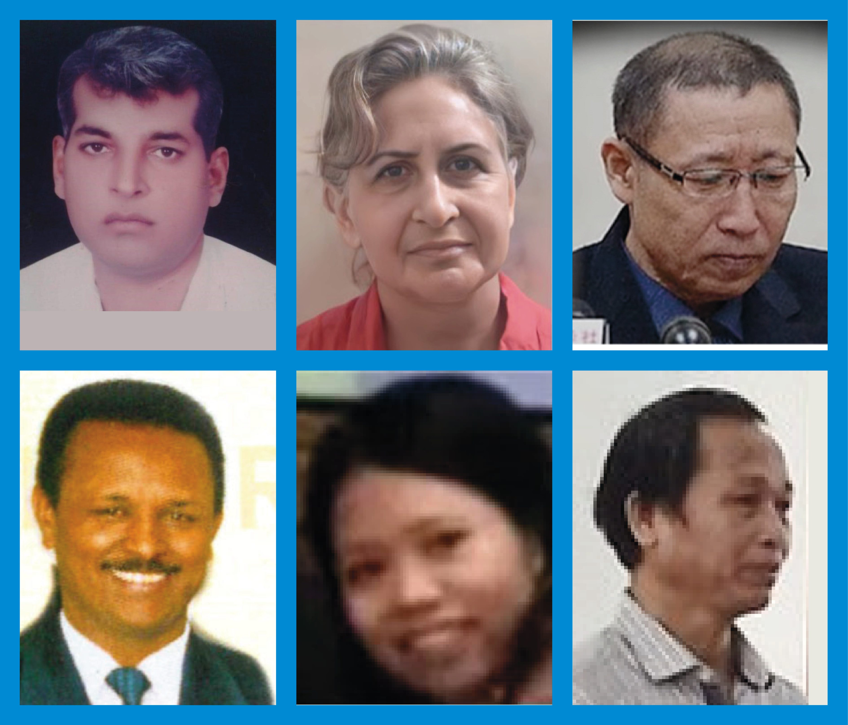
Lent Prayer Project

Slide 2
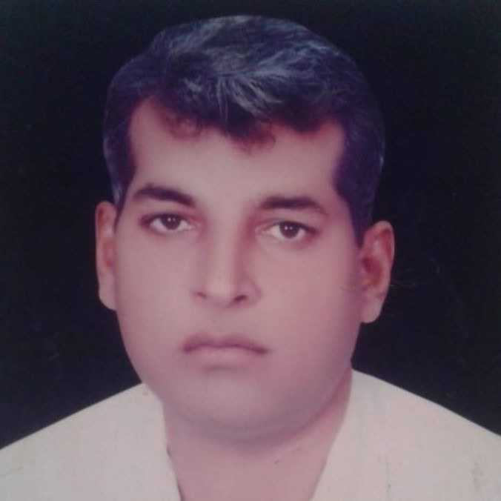
Lent Prayer Project: Week 1
Zafar Bhatti
Pakistan
Death Sentence

Slide 3
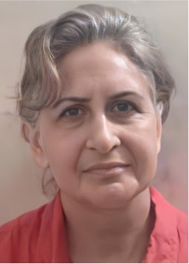
Lent Prayer Project: Week 2
Mina Khajavi
Iran
6-Year Sentence

Slide 4
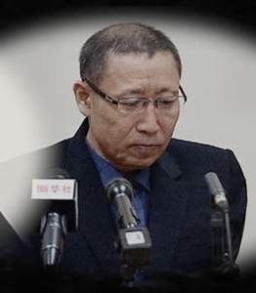
Lent Prayer Project: Week 3
Choi Chun-gil
North Korea
Life Sentence

Slide 5
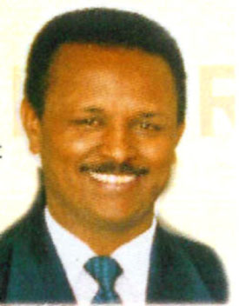
Lent Prayer Project: Week 4
Haile Naizghe
Eritrea
No release date

Slide 6
Lent Prayer Project: Week 5
Fu Xuanjuan
China
6-Year Sentence

Slide 7
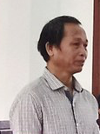
Lent Prayer Project: Week 6
Nay Y Blang
Vietnam
4 ½ -Year Sentence

